Slide 1

DEPARTMENT OF COMPUTER SCIENCE AND ENGINEERING Internship Presentation on “Leaf Now” By DHARINI K R 4VM18CS009
VIDYA VIKAS INSTITUTE OF ENGINEERING AND TECHNOLOGY #127-28, Bannur Road, Alanahally Post, Mysuru-570028
Under the Guidance of
Internal Guide
Prof. Latha D U Assistant Professor,
Dept of CSE
Prof. Latha D U Internship Coordinator Assistant Professor,
Dept of CSE
External Guide
Dhanush S Project Mananger,
Compsoft technology

Slide 2
Contents
About the Company
Introduction
Requirements
Design /Block Diagram
Implementation
Snapshots
Reflection
Conclusion
References

Slide 3
ABOUT THE COMPANY
It is Established as a private company.
COMPSOFT TECHNOLOGY SOLUTIONS INDIA PRIVATE LIMITED is known as the foremost service provider.
It provides high-quality range of Web Technologies, Strategic Outsourcing, Custom Application Offered Web Technologies, Strategic Outsourcing, Custom Application are well-known for the features like long working life, high functionality, and low maintenance.
The global telecommunication infrastructure is a highly meshed network which provides real-time communication from any point in the world to any other point.

Slide 4
INTRODUCTION
Leaf Now is the web platform which is designed to help the people to buy the small plants for décor or planting purpose.
The main aim of the leaf now to create a better platform for the better interaction between the client and the management .
By this the management can provide the good service regarding their requirements.
Here we are using different frontend language to create a plant selling web portal.

Slide 5
OBJECTIVES
The main objective of this project is to provide a platform to buy the plant of their like in the minimum cost from anywhere.
It also maintain the good communication between the client and plant seller.

Slide 6
REQUIRMENTS
HARDWARE:
Processor (CPU) with 2 gigahertz (GHz) frequency or above
A minimum of 2 GB of RAM
Monitor Resolution 1024 X 768 or higher
A minimum of 20 GB of available space on the hard disk
SOFTWARE:
Operating System :- Microsoft Windows 8.1, 64 bit
Coding Language Front End :- CSS , HTML, Java Script
Database Server :-Xampp server
Browser :- Google

Slide 7
BLOCK DIAGRAM
LEAF NOW
Home
Category
Products
Deal of the day
Contact
Name
Email
Number
Message
Plants for house
Plants for office
Plants for gifts
Send Message

Slide 8
IMPLEMENTATION
The front-end technologies used are: HTML, CSS, Java Script.
HTML:
HTML stands for Hyper Text Markup Language. It is the standard markup language for creating Web pages which describes the structure of a Web page
HTML consists of a series of elements which tell the browser how to display the content.
Some of the HTML tags used are header tag, paragraph tag, div tag, section tag, img tag, li tag.

Slide 9
SL NO | TAG TYPE | EXAMPLE
1 | Meta tags | DOCTYPE, title, link, meta and style
2 | Text tags | <p>, <h1>, <h2>, <h3>, <h4>, <h5>, <h6>,
3 | Link tags | <a> and <base>
4 | Image and Object tags | <img>, <area>, <map>, <param> and <object>
5 | List tags | <ul>, <ol>, <li>, <dl>, <dt> and <dd>
6 | Table tags | table, tr, td, th, tbody, thead, tfoot, col, colgroup and caption

Slide 10
CSS:
CSS(Cascading Style Sheets), is a rule-based language — you define rules specifying groups of styles that should be applied to particular elements or groups of elements on your web page.
While HTML is used to define the structure and semantics of your content, CSS is used to style it and lay it out.
Example
.heading{
font-size: 3rem;
color: #444;
padding-left: 1rem;
border-left: .4rem solid var(--green);
margin-top: 1rem;
margin-bottom: 3rem;
}

Slide 11
JAVA SCRIPT
JavaScript (js) is a light-weight object-oriented programming language which is used by several websites for scripting the webpages. It is an interpreted, full-fledged programming language that enables dynamic interactivity on websites when applied to an HTML document.
JavaScript is an object-based scripting language which is lightweight and cross-platform.
JavaScript is not a compiled language, but it is a translated language. The JavaScript Translator (embedded in the browser) is responsible for translating the JavaScript code for the web browser.

Slide 12
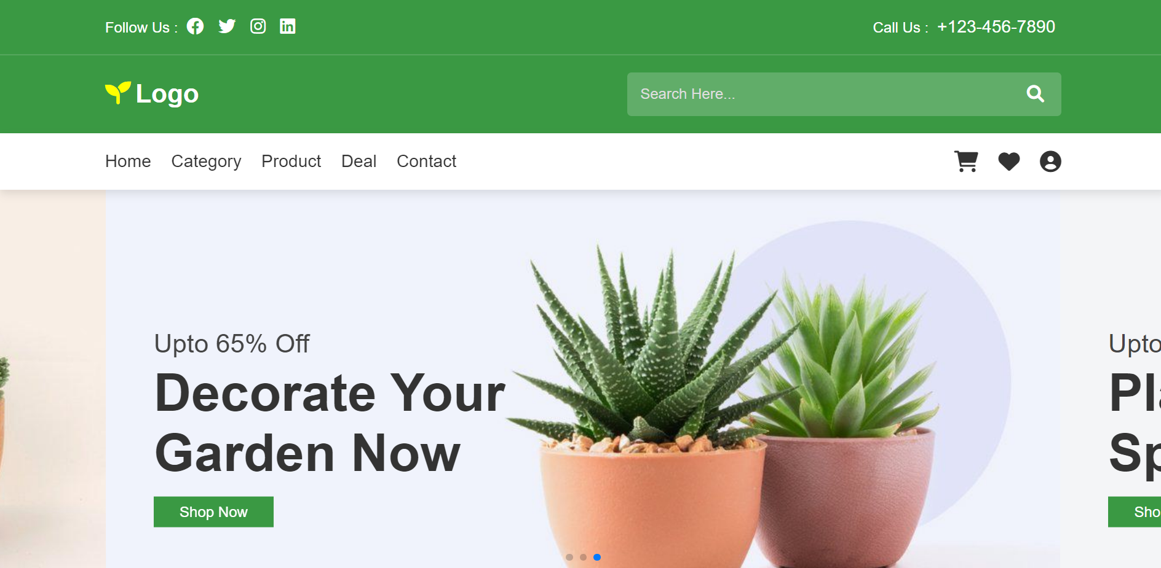
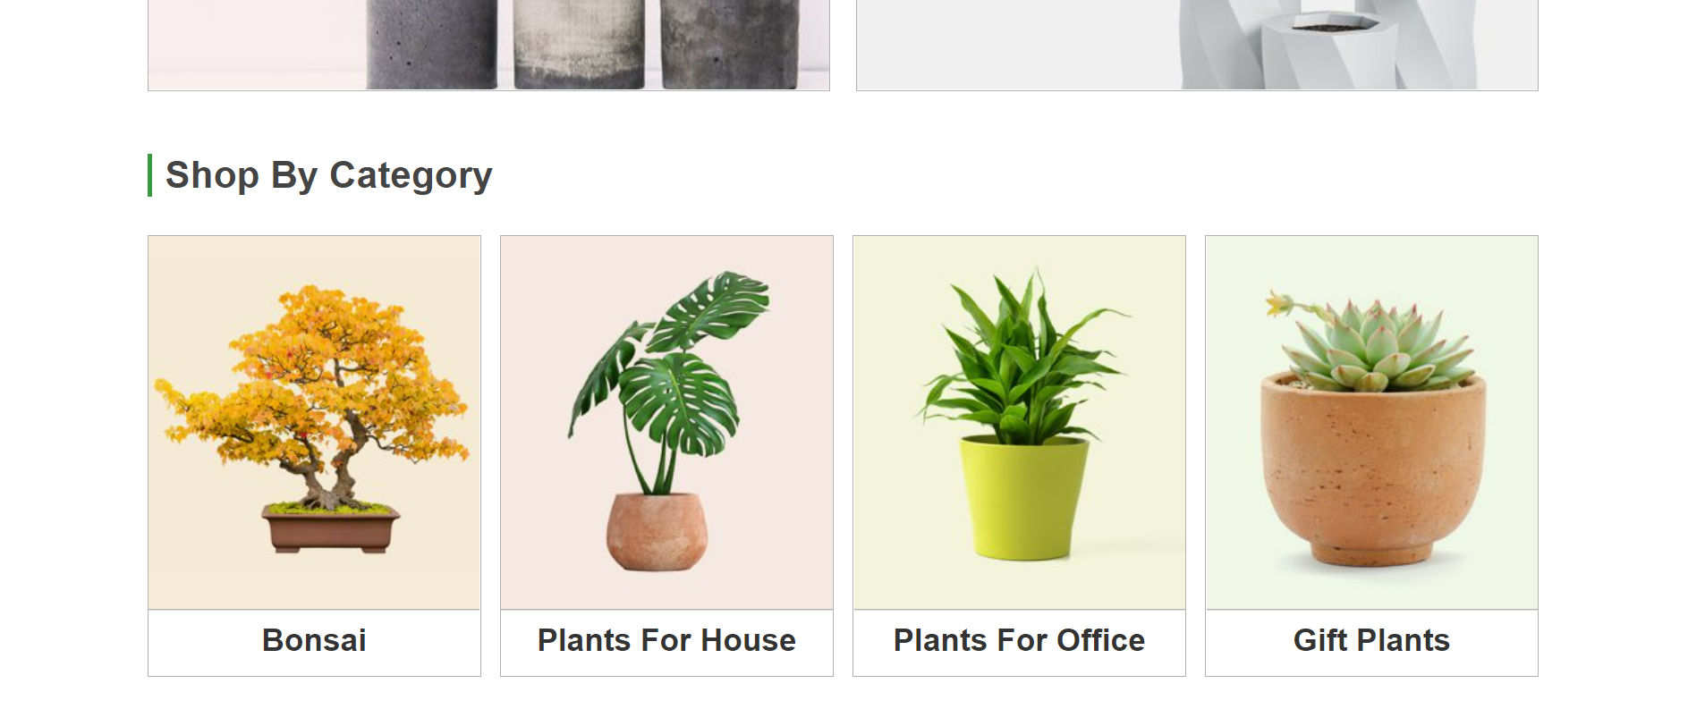
Snapshots

Slide 13
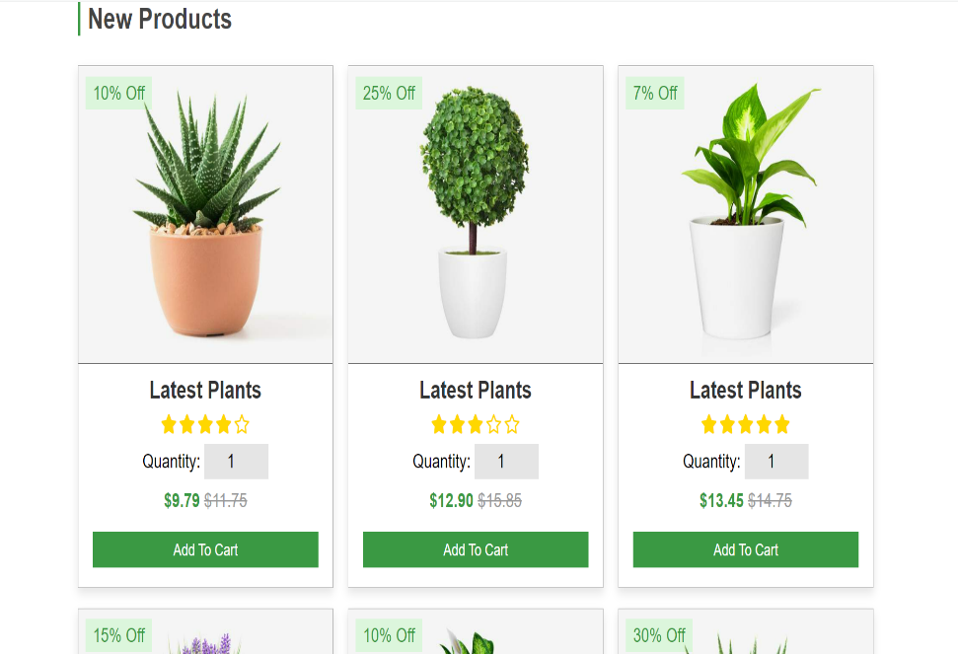
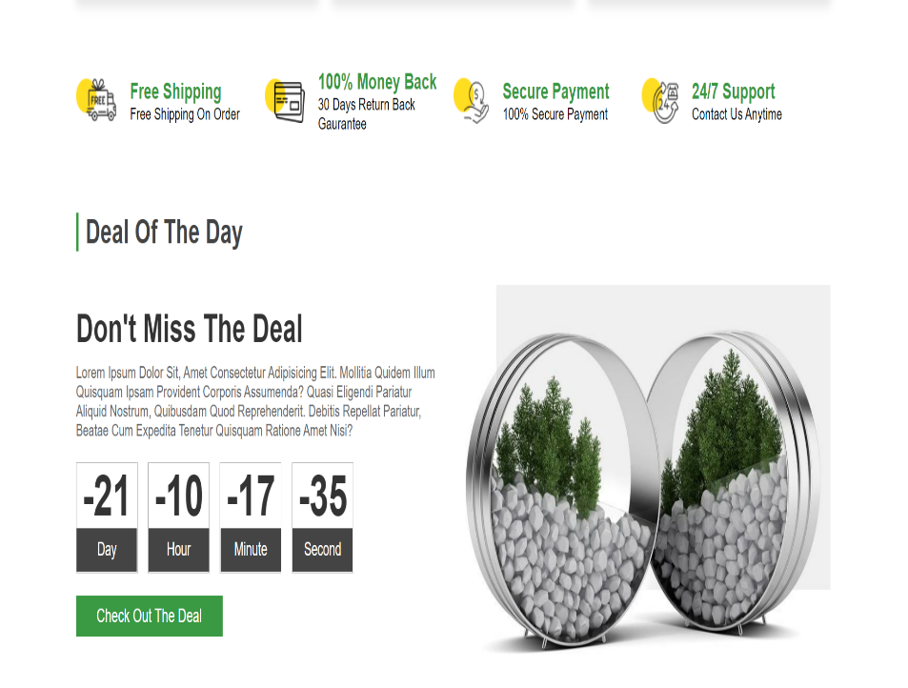
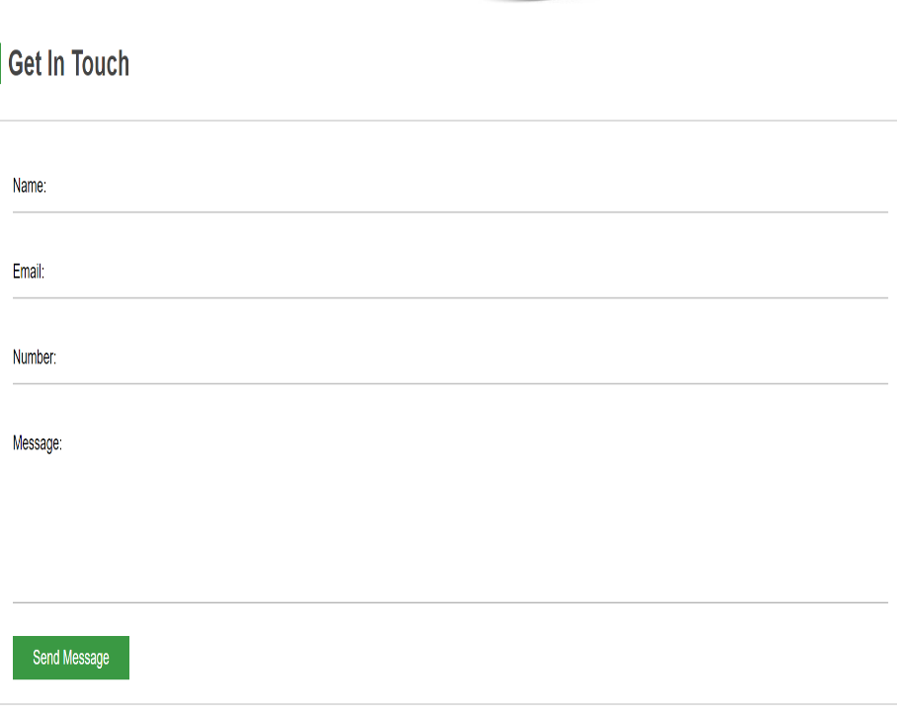

Slide 14
REFLEXTION
I have improved the skills like interpersonal, listening, presentation skills, communication skills.
Experts in web development interacted with us through which I acquired practical knowledge .
This internship gave me exposure to different people with innovative ideas .
It has helped guide my carrier aspirations and will help me in my future carrier choices.

Slide 15
CONCLUSION
The completed and rigorous training program in web development at the end of the program I got practical knowledge about the web development and its various interesting features.
Working under various people in the team has made me to thoroughly understand the process of application development.
It is through this training program and work culture, I came to understand that there is vast difference between getting trained as a student in college and the real time environment.

Slide 16
REFERENCE
www.W3School.com
www.Javatpoint.com
Robin Nixon, “Learning PHP, MySQL &JavaScript with jQuery, CSS and HTML5”, 4th Edition, O’Reilly Publications, 2015.
Luke Welling, Laura Thomson, “PHP and MySQL Web Development”, 5th Edition, Pearson Education, 2016.

Slide 17
THANK YOU

